Slide 1


Slide 2
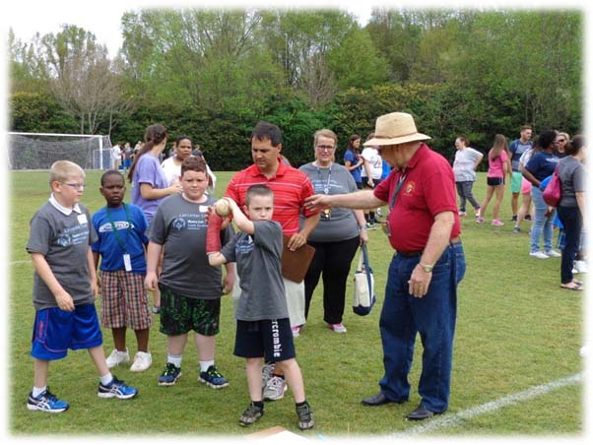
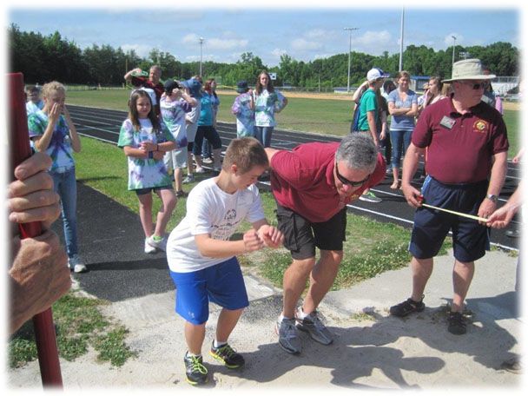
Our Mission
“…bettering the environment for, and increasing the self-reliance and dignity of people with Intellectual Disabilities and special needs… these individuals should have the community support, tools and resources necessary to lead independent productive lives…”

Slide 3
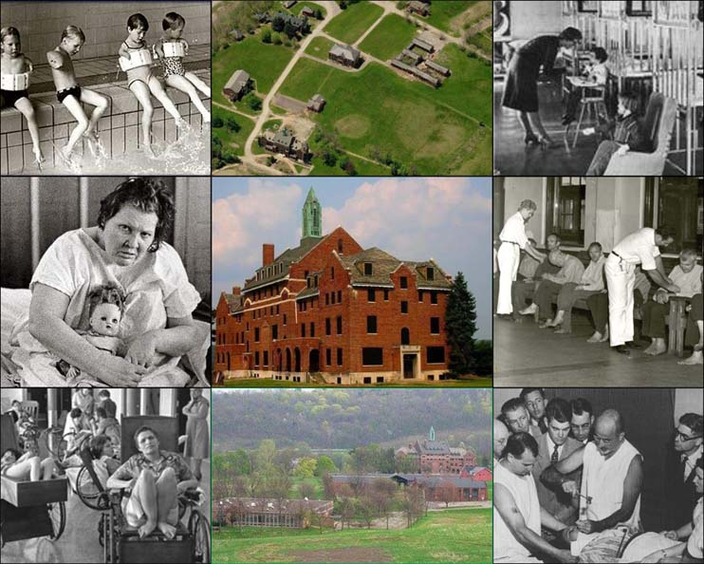

50+ years ago…
Very little support for the family
Only other option was a mental institution ranging from asylums to hospitals.

Slide 4
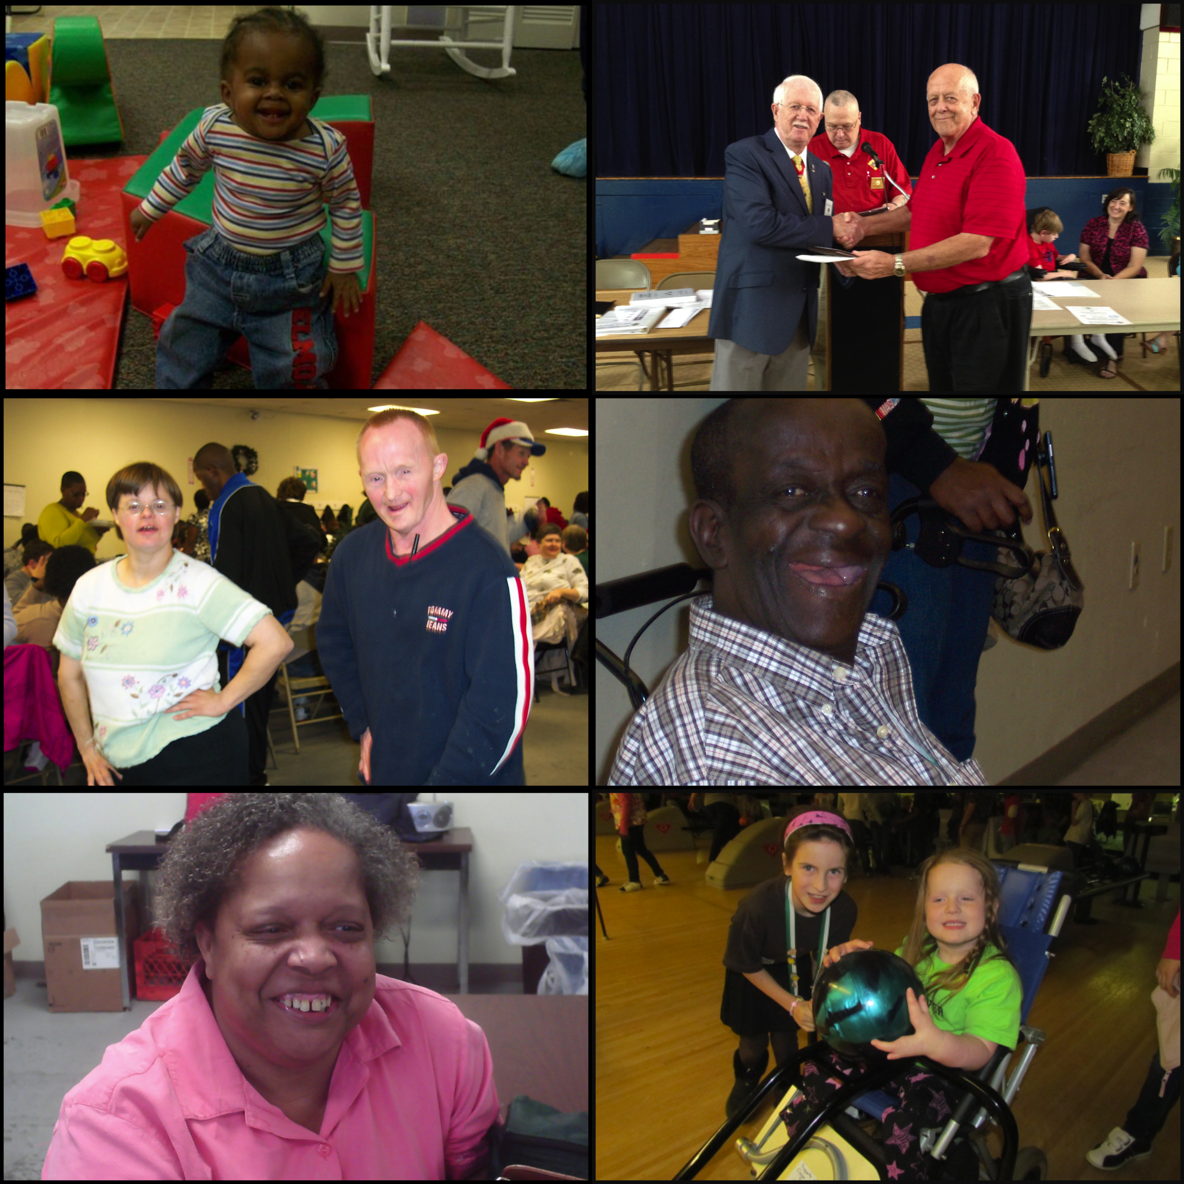
Present Day…
Home and Community based services
Client driven support

Slide 5
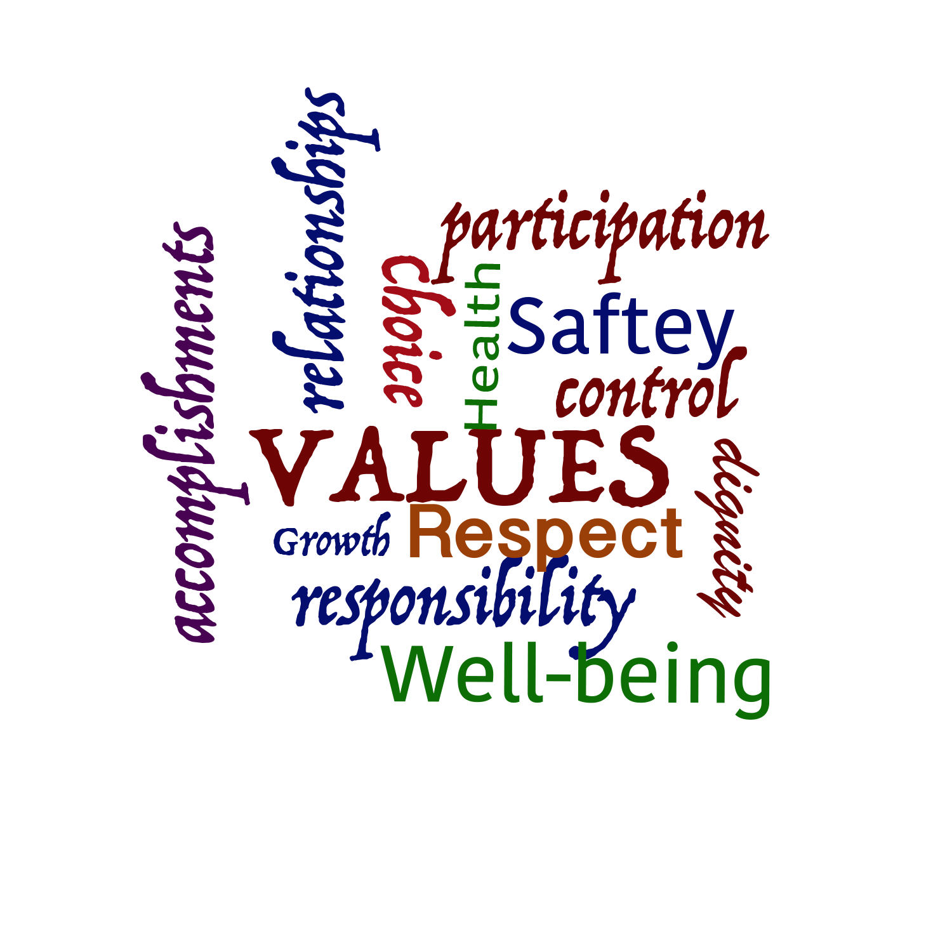

Values
Health, safety and well-being of each person
Dignity and respect for each person
Individual and family participation, choice, control and responsibility
Relationships with family, friends and community connections
Personal growth and accomplishments
Service and Support
Early Intervention
Family Support
Adult Development Services
Residential Services

Slide 6
Values
Health, safety and well-being of each person
Dignity and respect for each person
Individual and family participation, choice, control and responsibility
Relationships with family, friends and community connections
Personal growth and accomplishments
Self Reliance in the Community
Family
Assisted
Home
Supervised Living
Community Training Homes
Community Intermediate Care Facilities
Service and support
24 Hour Care
Center
Regional Residential Centers
Early Intervention
Family Support
Adult Development Services
Residential Services

Slide 7
DDSN Mission Overview
Who is eligible for services? DDSN currently has 37,389 individuals with intellectual disabilities, autism, head & spinal cord injuries, and related disabilities eligible for services.
What services are provided? DDSN’s FY22 legislative appropriations of $828 million serves 21,529 individuals through a variety of resource mechanisms:
Medicaid At-Home Waivers (8,547);
Medicaid Residential Waivers (3,887);
Medicaid Community Intermediate Care Facilities (463);
Medicaid Regional Center Intermediate Care Facilities (601);
State funded equivalent Waiver services (222);
Early Intervention (3,772); and
State Funded Family Support (4,037).
How do we spend our funds? DDSN’s annual expenditures are used for the following:
Contracted services (DSN Board, Private Provider) (85.1%),
DDSN operated Regional Center Intermediate Care Facilities (12.0%),
DDSN operated Autism residential homes (0.2%), and
DDSN overhead (2.7%).

Slide 8
The Need Is Greater Than Resources Available
The waiver waiting lists are at an all-time high containing 14,456 individuals.
  Each waiver is at, or near, an all-time high in wait times: IDRD (5.4 years); Community Supports (3.6 years); and HASCI (0.4 years).
On 7/1/21, DDSN re-engineered its waiver waiting list to more efficiently implement new legislative appropriated waiver slots.
DDSN requested $6.36 million ($1.9 million state funds) to fund 300 IDRD Waiver slots ($14,000/waiver slot) and 60 HASCI Waiver slots ($36,000/waiver slot). (Recurring)

Slide 9
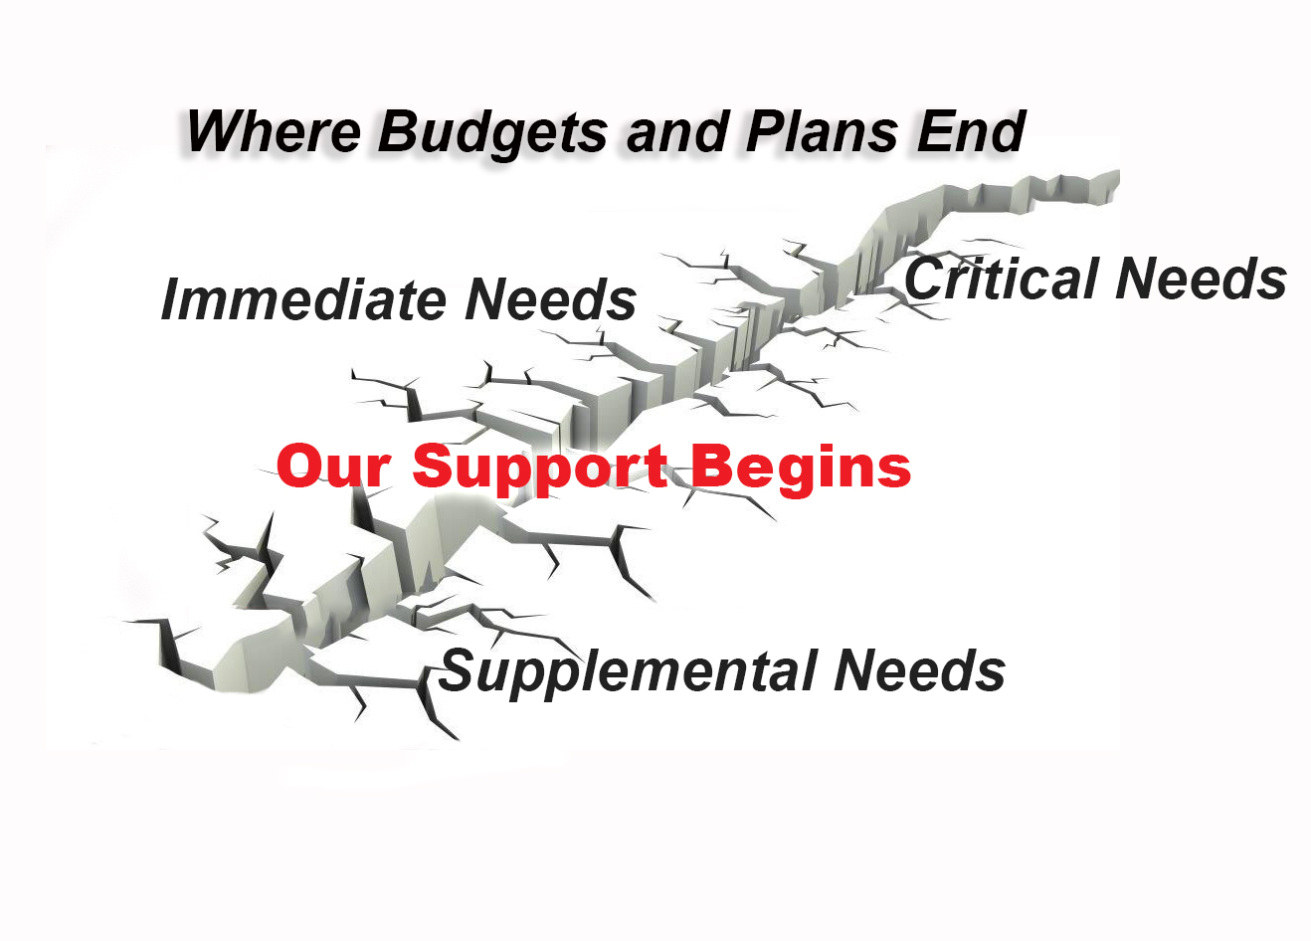

Slide 10
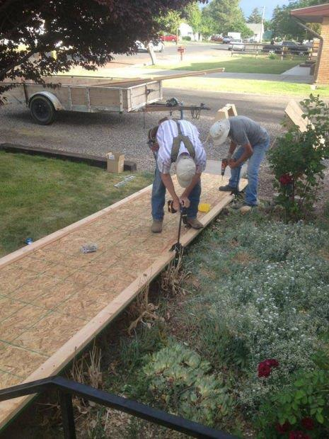
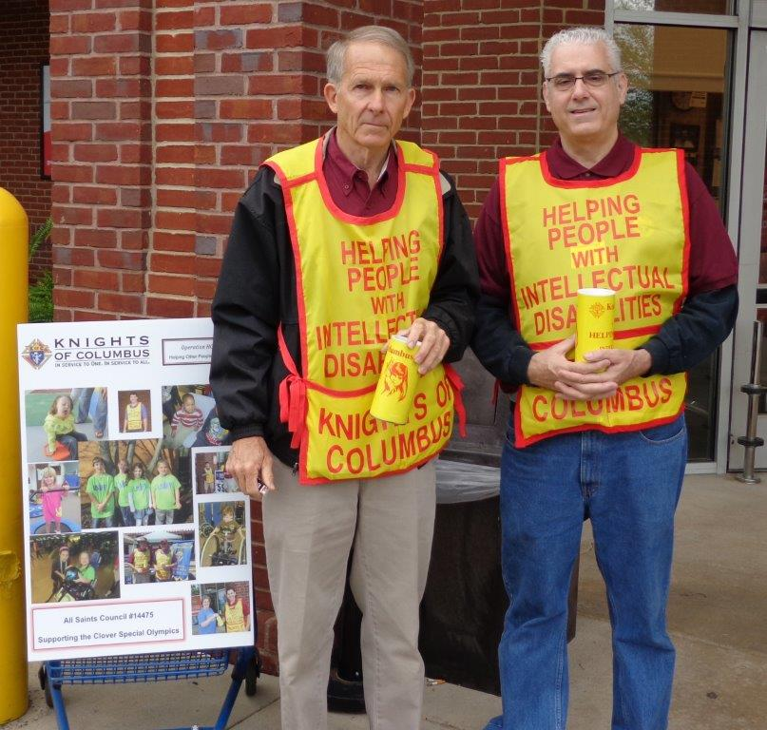
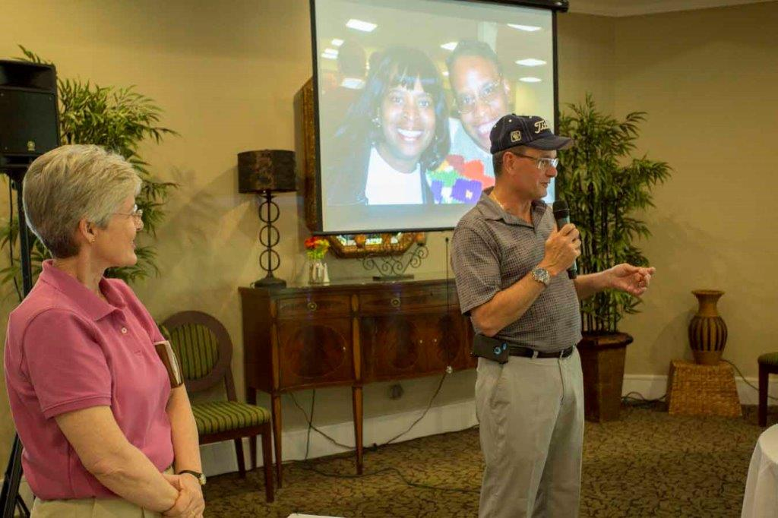
What We Do
We Raise Funds
We Serve
We Advocate
Since its inception in 1976 the Columbus HOPE Foundation raised more than “7 Million Dollars” to assist South Carolina citizens with Intellectual Disabilities and Special Needs.

Slide 11
Delivering Results
“…Through our support of non-profit service organizations that share this philosophy and in partnership with the county disability boards we are making the world easier to navigate for thousands of people every day…”

Slide 12
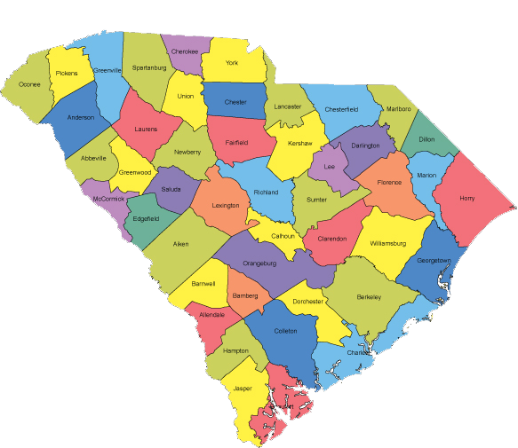
Columbus HOPE Funds
98% to service and support programs
85% allocated locally to the fundraising
15% allocated to statewide service and support programs

Slide 13
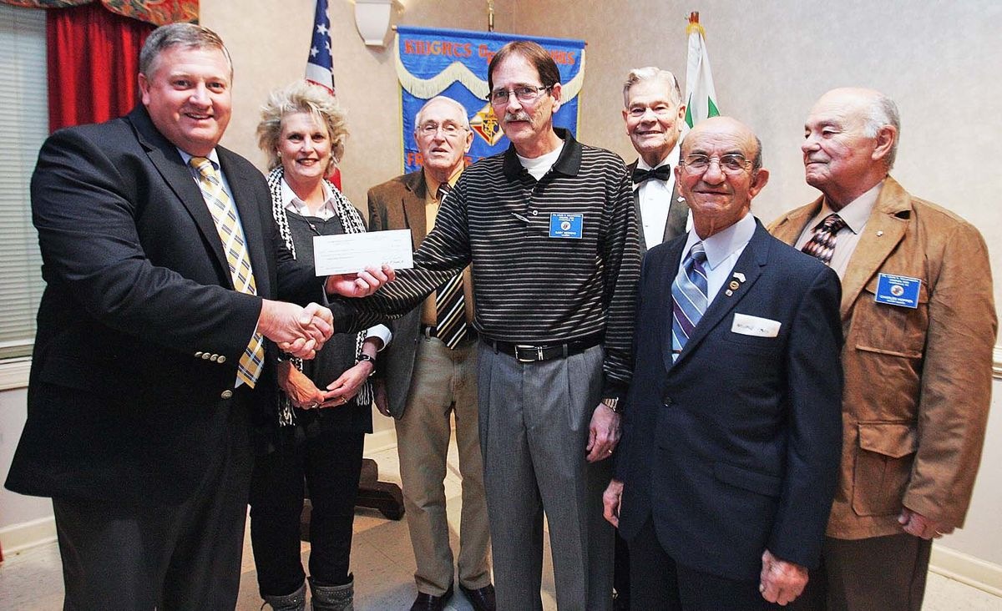
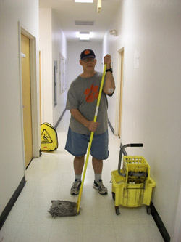
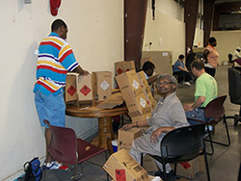
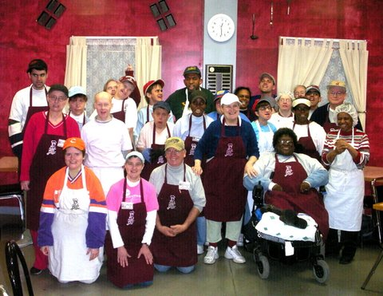
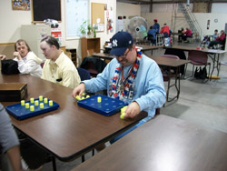
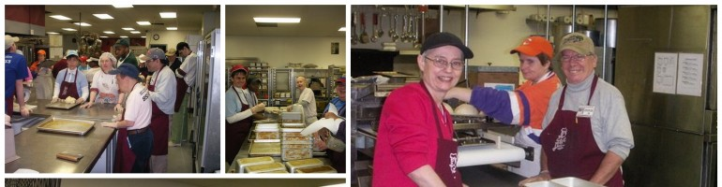
Adult Development Software, Tools and Equipment

Slide 14

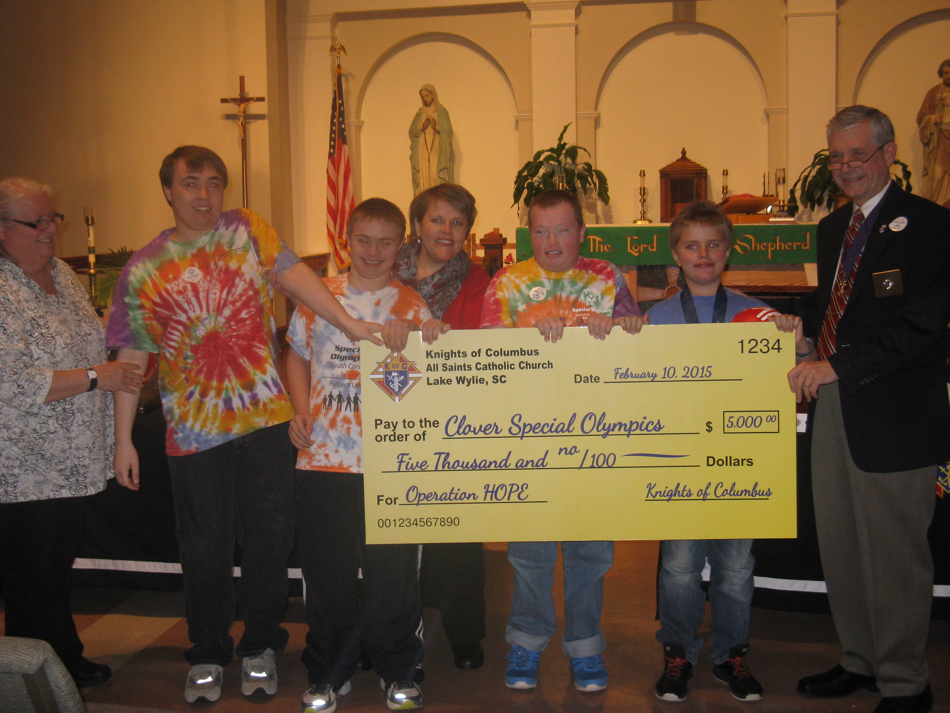
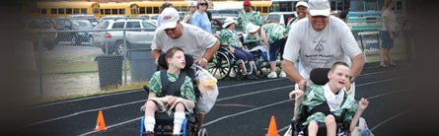
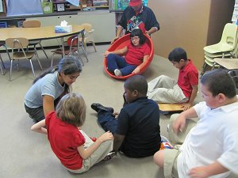

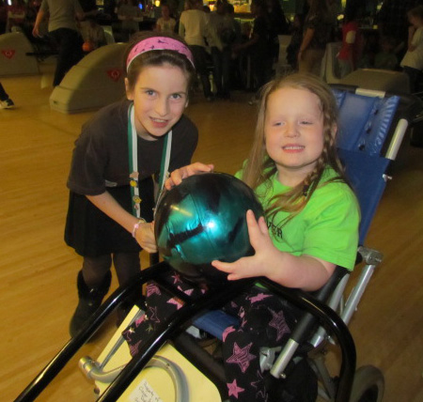
Self Contained Class Room
Special Olympics

Slide 15

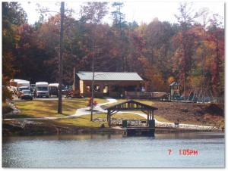
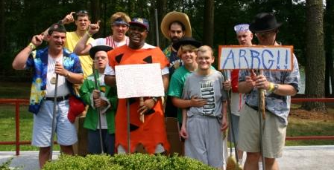
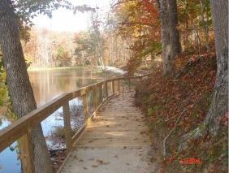
Dignity, Connection, Growth, Happiness

Slide 16
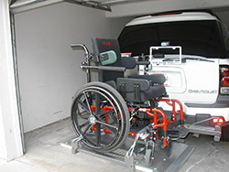
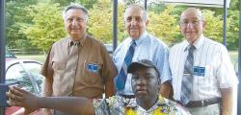
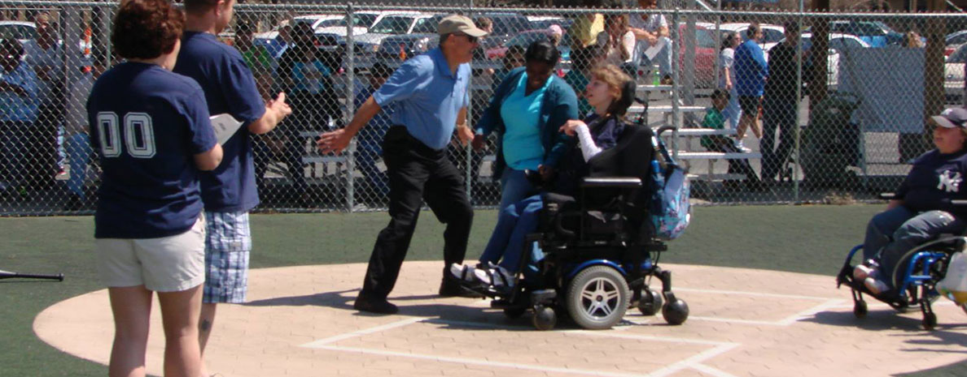
Self-Reliance, Independence, Accessibility

Slide 17
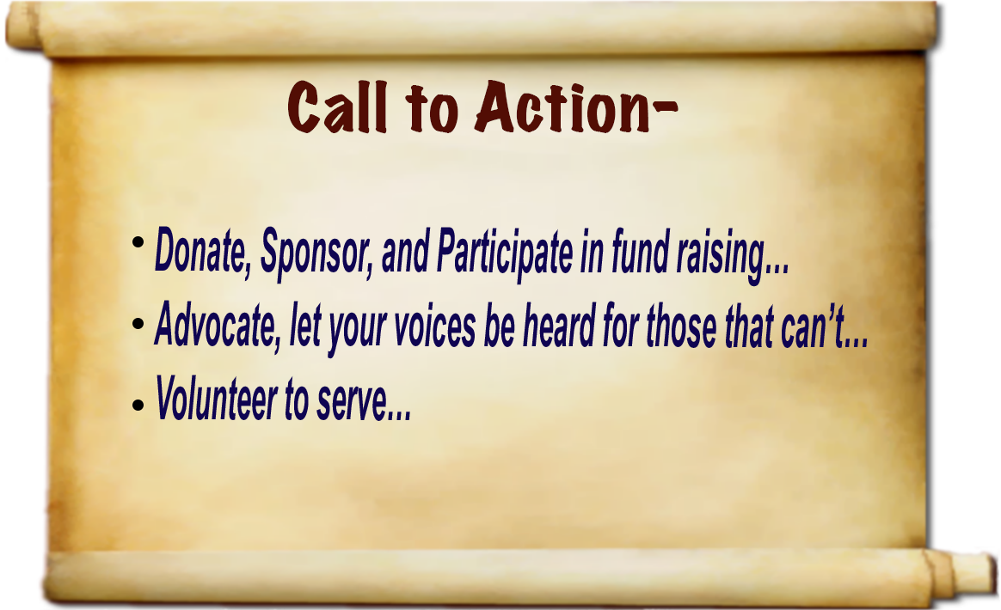

Slide 18


Slide 19
Or Contact us at
www.ColumbusHOPE.org
Or at:
tdemars@ColumbusHOPE.org
(843)437-1021

